Slide 1

Travel And Transportation
Team Members
1.Manali Gaikwad
2.Priyanka Mote
3. Apurva Rudrawar
4. Akshada Chavan
Guided By
Mr. Kushal Sharma Sir

Slide 2
Objective
In this project, we aim to understand customer complaints on social media, specifically Twitter, regarding the major airlines in the US.
To identify the positive ,negative and neutral Sentiments of the customers about the airlines.
Which airlines gets the most tweets.
We get Know where we are doing good and where we are doing bad.
can be a basis for a predictive model when we associated tweets length with sentiment.
Companies can get to know their competition.
Improve the flight journey overall.

Slide 3
Introduction
In this project, we use tweets gathered from Twitter to learn about people’s flight experiences and give airline companies suggestions on how to make their trip more enjoyable. The data set contains about 15,000 tweets, collected from February 2015 on various airline reviews. Every review is labeled as either positive, negative or neutral.
We perform this in python and tableau,power BI,Pig,Hive.

Slide 4
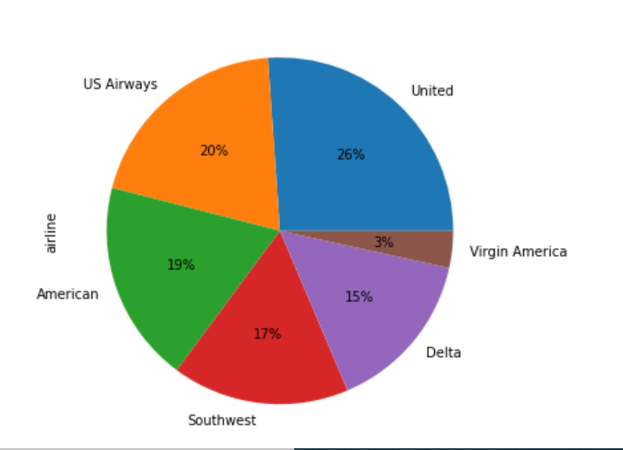
Numbers Of Tweets -

Slide 5
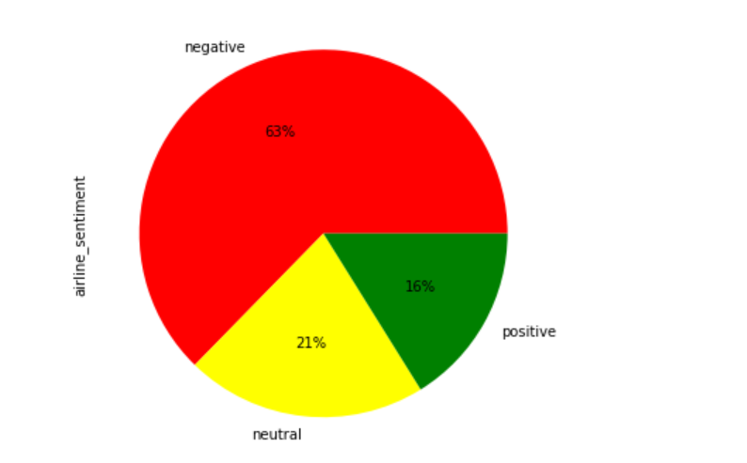
Overall Sentiments-
Negative =63%
Positive=16%
Neutral=21%

Slide 6
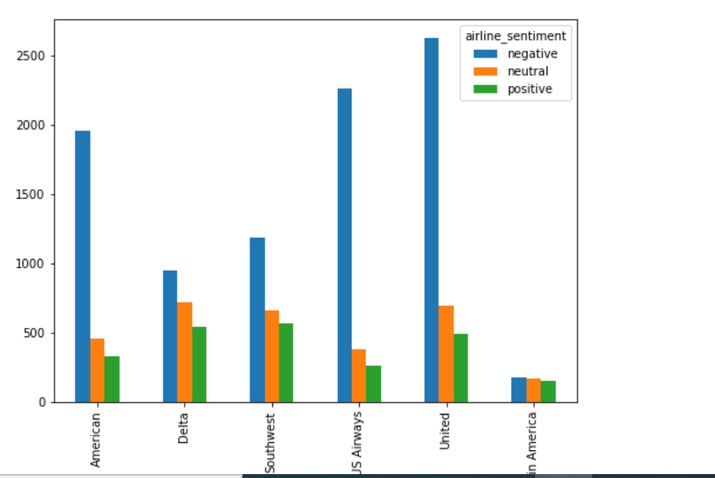
Sentiments Per Airline-

Slide 7
Result
Random forest Accurancy:0.75
predict whether a tweet contains positive, negative, or neutral sentiment about the airline.

Slide 8
Thank You….

